Slide 1
Time series forecasting of GDP in India using ARIMA Model
SUBMITTED BY:
DIKSHA
GURBINDER SINGH
MANISHA RANI
SHIKHA

Slide 2
Contents
Introduction to project
Project Aims to
Introduction :
Time series
Gross domestic product
Methodology:
Analysis using ARIMA model
Time series forecasting
Conclusion

Slide 3
INTRODUCTION TO PROJECT:
Gross domestic product is one of the most important economic indicators of the country and its positive or negative growth indicates the economic development of the country. It is calculated quarterly and yearly at the end of financial year. The GDP growth of India has seen fluctuations from last few decades .
To keep track on GDP growth for deciding the economic policies of the country , we are analyzing and forecasting the GDP growth using the time series forecasting technique ARIMA model.

Slide 4
Project Aims To:
To test the stationarity in the data of GDP over the period.
To study autocorrelation in the observed series of GDP.
Analysis of GDP growth trend in India from 1951 to 2020
Forecasting of GDP growth trend in India from 2021 to 2030

Slide 5
INTRODUCTION
TIME SERIES IS :
a set of data depending on the time.
A series of values over a period of time.
Collection of magnitudes belonging to different time periods of some variables such as production of steel , per capita income, gross national income , index of industrial production.
In time series, time act as an independent variable to estimate dependent variable.

Slide 6
TIME SERIES ANALYSIS:
Time series analysis attempts to identify those factors that exert influence on the values in the series.
Time series analysis is a basic tool for forecasting.
Industry and government must forecast future activity to make decisions and plans to meet projected changes.
An analysis of the trend of the observations is needed to acquire an understanding of the progress of events leading to prevailing conditions.
Examples – stock prices, heartbeats per minute , annual retail sales etc.

Slide 7
COMPONENTS OF TIME SERIES:
TREND- The general tendency of the data to grow or decline over a long period of time.
Example: Population growth ,Formation of rocks.
SEASONAL VARIATION- The component responsible for the regular rise or fall in the time series during a period not more than one year .
the factors that cause seasonal variations are climate and weather conditions , customs , traditions and habits

Slide 8
CYCLIC VARIATIONS: These are long term movements that represent consistently recurring rises and declines in activity.Cyclical variations usually last longer than a year.
It consists of four phases : Prosperity, Decline , Depressions , Recovery .
IRREGULAR VARIATIONS: These are also called random variations .They do not follow a definite pattern.
Example: fire , floods , earthquakes , strikes.

Slide 9
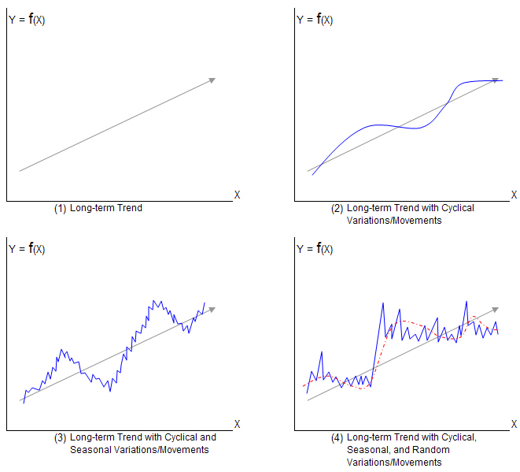
MATHEMATICAL PRESENTATION OF TIME SERIES
Mathematically,
A time series is defined by the values Y1, Y2,..... of a variable Y at times t1, t2, .....
Thus , Y=F(t)

Slide 10
GROSS DOMESTIC PRODUCT (GDP):
Gross domestic product (GDP) is the total monetary or market value of all the finished goods and services produced within a country’s borders in a specific time period
GDP provides an economic snapshot of a country, used to estimate the size of an economy and growth rate.
GDP can be calculated in three ways, using expenditures, production, or incomes.
It can be adjusted for inflation and population to provide deeper insights.

Slide 11
Types of Gross Domestic Product
Nominal GDP - Nominal GDP is an assessment of economic production in an economy that includes current prices in its calculation.
Real GDP - Real GDP is an inflation-adjusted measure that reflects the quantity of goods and services produced by an economy in a given year, with prices held constant from year to year to separate out the impact of inflation or deflation from the trend in output over time.

Slide 12
COMPONENTS OF GDP
Consumption(C)
Investment (I)
Government spending ’s (G)
Net exports (X-M)
where X – exports
M- imports
GDP can be calculated by
GDP = C+G+I+(X-M)

Slide 13
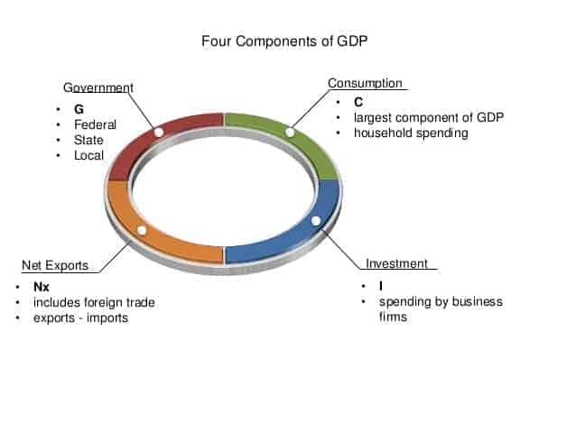

Slide 14
METHODOLOGY:
Data Collection
Analysis of Data using ARIMA model
Time Series Forecasting
Validation of Results

Slide 15
Data Collection :
We have collected the GDP growth data for India from 1951-2020 from a comma separated (CSV) file available for download on the official website of Open Government Data (OGD) Platform India, and uploaded that in Excel 2013.Then data was cleaned , extracted and converted into Time series data to be used for analysis and forecasting in R studio software.

Slide 16
ANALYSIS USING ARIMA MODEL:
Introduction to ARIMA Model :
Acronym for ARIMA is Auto Regressive Integrated Moving Average.
It is a prediction model used for time series.
Example: Measuring the level of unemployment each month of the year would comprise a time series.
Here the terms are :
Auto Regressive : lags of variable itself
Integrated: Differencing steps required to make data stationary .
Moving Average: lags of previous information shocks.

Slide 17
A non seasonal ARIMA model is classified as an “ARIMA ( p , d , q )” model , where :
p is the number of autoregressive terms .
d is the number of non seasonal differences needed for stationary , and
q is the number of lagged forecast errors in the prediction equations.
ASSUMPTIONS:
The data series used by ARIMA should be stationary.
By STATIONARY it means that the properties of the series does not depend on the time when it is captured.
A non stationary series is made stationary by differencing.

Slide 18
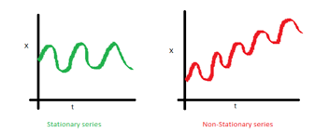
Data should be univariate – ARIMA works on a single variable. Auto - regression is all about regression with the past values.

Slide 19
ARIMA MODEL
Auto Regressive(AR) Model:
Value of a variable in one period is related to the values in previous period.
AR(p)- Current Values depend on its own p- previous values
P is the order of AR process
Ex : AR(1,0,0) or AR(1)
Moving Average (MA) Model :
Accounts for possibility of a relationship b/w a variable & residuals from previous period
MA(q) – the current deviation from mean depends on q previous observations
q is the order of MA process.
Only error terms are there
Ex. – MA (0 , 0 , 1) or MA (1)

Slide 20
ARMA model: Both AR and MA are there i.e. ARMA (1,0,1)
ARIMA model: If differencing term is also included i.e. ARIMA (1,1,1)
PROCEDURE FOR ARIMA MODELLING :
Ensure stationarity : Determine the appropriate values of d
Make correlograms ( ACF & PACF) : PACF indicates the AR terms and ACF will show the MA terms .
Fit the model : Estimate an ARIMA model using values of p , d , q you think are appropriate.
Diagnostic test : Check residuals of estimated ARIMA model ; pick best model with well behaved residuals.
Forecasting : Use the fitted model for forecasting purpose.

Slide 21
STEP 1 : STATIONARITY
In order to model a time series with the help of Box – Jenkins approach ,the series has to be stationary
If the process is non stationary then first differences of the series are computed to make data stationary.
The process is continued until a stationary time series is found.
This then determines the value of d
TESTING STATIONARITY:
DICKEY -FULLER TEST:
p value has to be less than 0.05
If p value > o.05 , you accept the null hypothesis , you conclude that the time series has a unit root.
In that case you should first differnce the series

Slide 22
WHAT IS DF TEST?
Imagine a series where a fraction of the current value is depending on a fraction of previous values of the series .
DF builds a regression line between fraction of current value and fraction of previous value.
If p value of DF test is < 5 % then the series is stationary .
STEP 2 : MAKING CORRELOGRAMS:
Autocorrelation Function :
It is a correlation between 2 values of the same variable at times Xi and Xi+k.
Correlation with lag 1,lag 2, lag 3 ,etc.
The ACF represents the degree of persistence over respective lags of a variable.

Slide 23
Partial Autocorrelation function:
The “partial” correlation between two variables is the amount of correlation between them which is not explained by their mutual correlation with a specified set of other variables.
Partial correlation measures the degree of association between two random variables , with the effect of a set of controlling random variables removed .

Slide 24
FIT THE MODEL
Fit model based on AR and MA terms.
Make use of auto.arima (x) function , where x is data series. It will do various combination of AR and MA terms and find the best model based on lowest AIC (Acyle Information Criteria).
For fitting model use arima( x , order = c( p , d, q)) function.
Order = c(p , d, q ) is model received from auto.arima(x) function.

Slide 25
DIAGNOSTIC TEST
First find the Residuals : use residuals (model) function .
Ex. - fit_resid = residuals(fit).
Now, do diagnostic on all these residuals ( A residual in forecasting is the difference between an a observed value and its forecast based on other observations : ei = yi – y^i . For time series forecasting , a residual is based on one step forecasts; i.e. Y^t is the forecast of yt based on observations y1,......, yt-1 . ).
If residuals are IID i.e. Having no autocorrelation then the model is fit.
For diagnostic use different tests, ex , Ljung Box test. Make use of Box.test() function to find p.
If p- value is non- zero then no serial autocorrelation is there & model is fit & can be used for forecasting purposes.

Slide 26
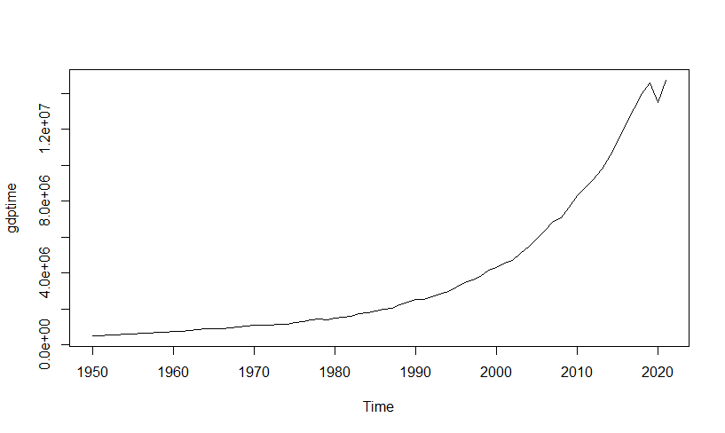
ANALYSIS IN R-
Graph of collected data on GDP in India from year 1951-2020
To check stationarity of data , we have used Augmented Dickey Fuller test
adf.test(gdptime)
Dickey-Fuller = 2.5501, Lag order = 4, p-value = 0.99
Here, p-value is greater than 0.05
This implies that Data is non- stationary, so we have to make it stationary by differentiation.

Slide 27
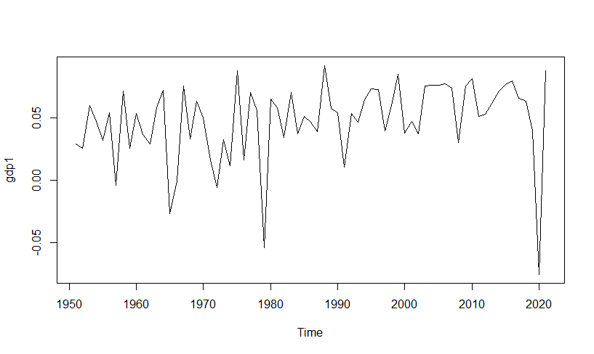
#Make Stationary
gdp1=diff(log(gdptime))
adf.test(gdp1)
Dickey-Fuller = -4.2826, Lag order = 4, p-value = 0.01
Now , p value is less than 0.05
This implies data become Stationary

Slide 28
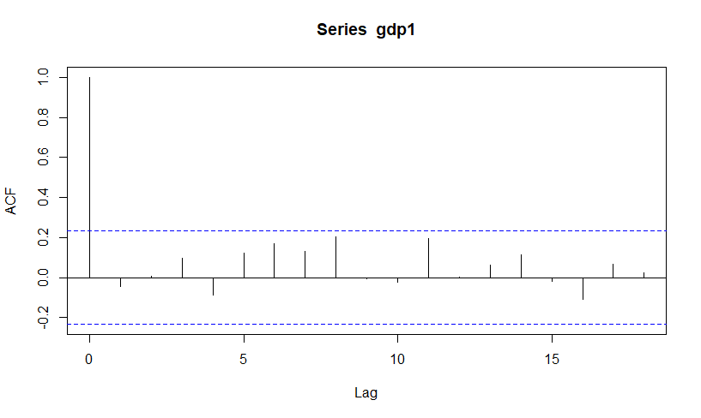
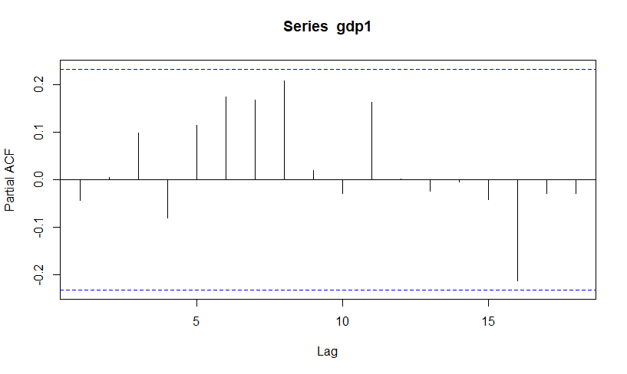
acf(gdp1) pacf(gdp1)
#Fit the Model
gdpmodel = auto.arima(gdptime,ic="aic",trace = TRUE)
Best model: ARIMA(1,2,1)
Coefficients:
AIC=1948.18 AICc=1948.54 BIC=1954.93
#Forecast Future Values
Gdpforecast=forecast(gdpmodel,level = c(95),h=10)
plot(gdpforecast)

Slide 29
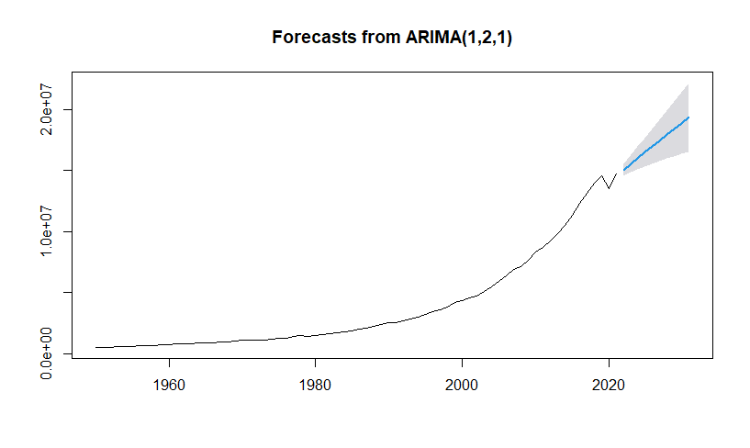
plot(gdpforecast)
Graph displays the Forecast plot for GDP growth in India from 2020-2030 using ARIMA( 1,2,1 ) model based on the Indian GDP values of last 60 years i.e. from 1951-2020
#check Autocorrelation,
Box.test(gdpforecast$resid,lag=5,type="Ljung-Box")
X-squared = 1.3393, df = 5, p-value = 0.9308

Slide 30
CONCLUSION-
We conclude that the GDP forecast for the next decade is increasing over the period of time .
The ARIMA(1,2,1) model was found to be a better fit model in forecasting India’s GDP.
Although the GDP of the country can be influenced by different conditions and thus predictions can vary in the future. Also the RBI should take necessary steps as and when needed to regulate different rates to keep the Indian economy stable.

Slide 31
THANKYOU……!

